Slide 1
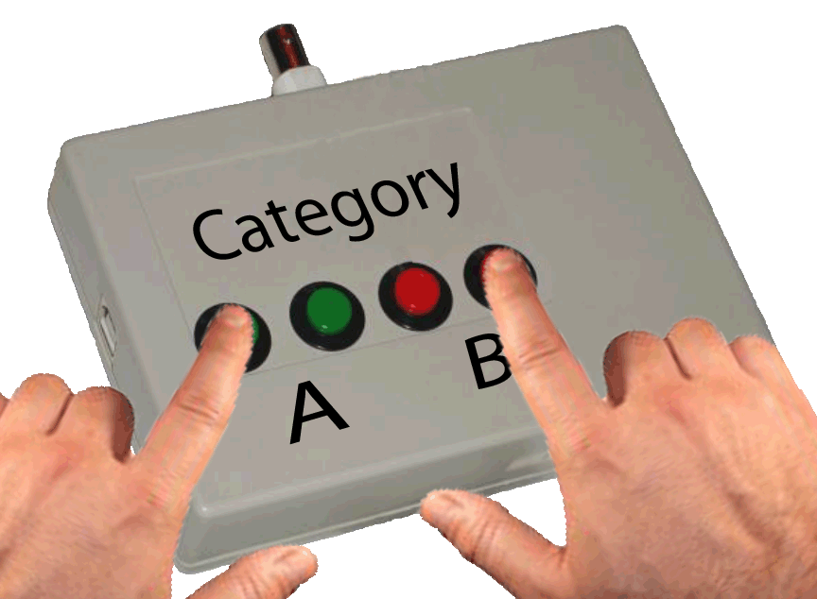
In this experiment, you will be asked to make responses using the Response Box, which looks like the one pictured below.
You will respond with Group A by pressing one of the left two buttons and Group B by pressing one of the right two buttons.
It is important that you keep your left index finger (or thumb) on one of the A buttons and your right index finger (or thumb) on one of the B buttons as pictured below.
Press any button for further instructions.

Slide 2
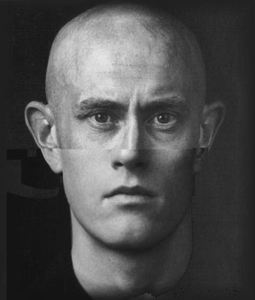
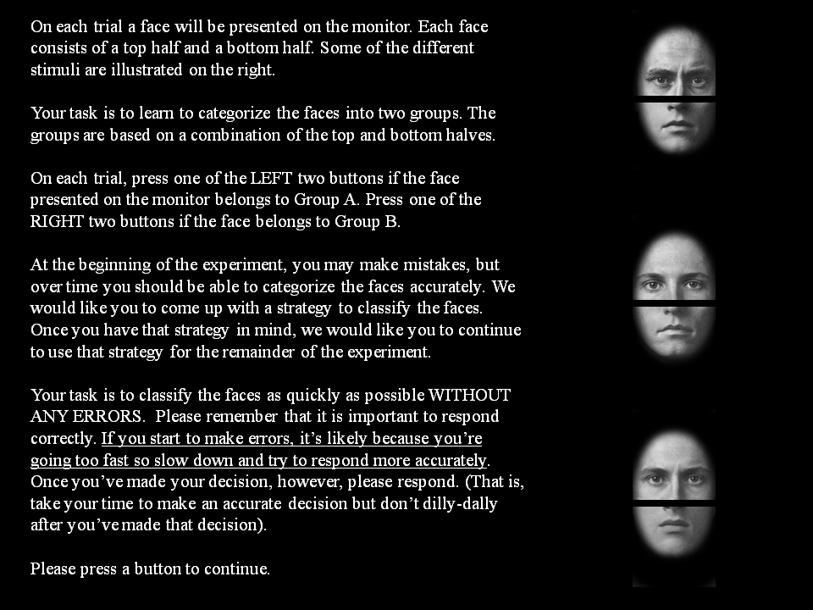

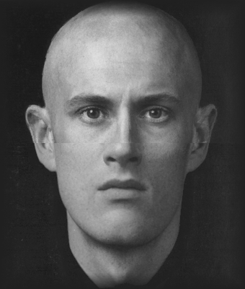
On each trial a face will be presented on the monitor. Each face consists of a top half and a bottom half like the faces illustrated on the right.
After the first face is presented a second face will be shown either (a) in the same upright aligned fashion, (b) the face will be upright but the top and bottom will be misaligned, (c) the face will be aligned but upside down, or (d) the face will be upside down and misaligned.
Your task is to say whether the TOP or the BOTTOM is the same or different. In each block, you will be told to either pay attention to the TOP half of the face or to pay attention to the BOTTOM half of the face.
On each trial, press one of the LEFT two buttons if the face half that you are told to attend to is the SAME. Press one of the RIGHT two buttons if the face half that you are told to attend to is DIFFERENT.
Your task is to respond as quickly as possible WITHOUT ANY ERRORS. Please remember that it is important to respond correctly.
Please press a button to continue.

Slide 3
Thank you for your participation!! Please call the experimenter!!

